Slide 1
Amortization and Problem Classification
P vs NP and General Problem-Solving Techniques
SoftUni Team
Technical Trainers
Software University
https://about.softuni.bg

Slide 2
Table of Contents
P vs NP
Heuristic Algorithms
Reduction
General Problem-Solving Techniques
Problem Solving
Five Steps for "Easy" DP
Generic Graph Algorithms
2
Notes:
2

Slide 3
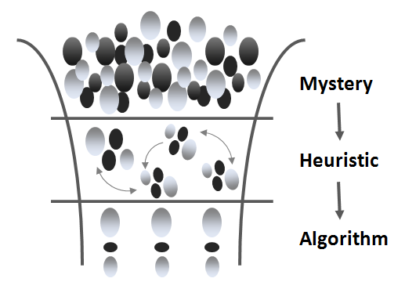
P vs NP
Heuristic Algorithms

Slide 4
Heuristic Algorithms
Some problems are hard to be solved (no fast algorithm exists)
Heuristic algorithms solve hard problems approximately
They find a good solution, but cannot guarantee it is optimal
Examples of heuristic algorithms:
Greedy algorithms – make a greedy choice at each step
Genetic algorithms – based on inheritance, mutation, selection
Branch and bounds – optimized backtracking with cut-offs

Slide 5
P vs NP
P - Category in which the algorithms are solvable in polynomial time
Polynomial -> 5N⁵ + 3N⁴ + N is O(N⁵)
Not a polynomial -> 2^{N}
P

Slide 6
P vs NP
NP - Category in which the algorithms are verifiable in polynomial time
Decision problems
Example:
Does a route shorter than L exist?
Yes/No
NP
P

Slide 7
P vs NP
Knapsack
(Can a value >= V be achieved?)
Subset sum
Set-Cover problem
NP-complete
Look-ups in hash tables
Sorting
Traversing lists
Finding shortest route
NP
P

Slide 8
P vs NP
At least as hard as NP-complete
Knapsack (maximize V)
Halting problem
Traveling salesman
NP-hard
NP-complete
NP
P

Slide 9
P vs NP
NP-hard
NP-hard
NP-complete
NP-complete
NP
NP
P
P

Slide 10
P vs NP
NP-hard
NP-hard
NP-complete
NP-complete
NP
NP
P
P

Slide 11
P vs NP
NP-hard
NP-hard
NP-complete
NP-complete
NP
NP
P
P

Slide 12
P vs NP
Millennium Problem
Prize of $1,000,000
Prove either P=NP or P!=NP
Currently > 100 attempts
NP-hard
NP-complete
NP
P

Slide 13
Reductions
A
B
Reducing Problem A to Problem B

Slide 14
Reduction
Convert problem A to problem B
B is a problem in P
Create A inputs into equivalent B inputs
Both problem A and problem B must output the same YES or NO answer for the input and converted input
If B is in P, then A is in P
If B is in NP, then A is in NP
If A is in NP Hard, then B is in NP Hard

Slide 15
Problem: 3SAT
Given a boolean formula:
Is there an assignment of variables to True and False, such that the entire formula evaluates to True?
3SAT ∈ NP because we can create a verifier
Verifier can compute whether can be evaluated to True in polynomial time
(x1 || x3 || x6) && (x2 || x3 || x7) && ...

Slide 16
Problem: 3SAT
Break down the problem:
Variable is True or False
Formula = && of 2 clauses each is || of variables
Proven to be NP-Complete by Cook in 1971
All problems in NP can be converted to 3SAT

Slide 17

Problem Solving
From Chaotic to Methodological Approach

Slide 18
Read and Analyze the Problems
Consider you are at a computer programming exam or contest
You have 5 problems to solve in 6 hours
First read carefully all problems and try to estimate how complex each of them is
Read the requirements, don't invent them!
Start solving the easiest / fastest to solve problem first!
Leave the most complex / slow to solve problem last!
Approach the next problem when the previous is well tested

Slide 19
Analyzing the Problems
Example: we are given 3 problems:
Cards Shuffle
Shuffle a deck of 52 cards in random order
Zig-Zag Matrix
Find the max-sum zig-zag path in a matrix
Start from the first column, go up, then down, then again up, them again down, …
Blocks
Generate all blocks 2 x 2 holding 4 of the first n Latin letters

Slide 20
Analyzing the Problems (2)
Read carefully the problem descriptions
Think a bit about their possible solutions
Order the problems from the easiest to the most complex:
Cards Shuffle
Trivial – randomize the elements of array
Blocks
Generate variations, rotate and check for duplicates
Zig-Zag Matrix
Needs summing, sorting and text file processing

Slide 21

Use a Sheet of Paper and a Pen
Never start solving a problem without a sheet of paper + a pen
You need to sketch your ideas
Paper and pen is the best visualization tool
Allows your brain to think visually
Paper works faster than keyboard / screen
Other visualization tools could also work well
21
Notes:
Use a sheet of paper and a pen when you solve programming problems!
Developers need paper, and this is not old-fashioned.
Never start solving a problem without a sheet of paper + a pen.
Trust me. I have very rich experience with programming contests and exams.
Why you need a sheet of paper and a pen?
Because you need to sketch your ideas.
And you should do this fast.
Paper and pen is the best visualization tool.
It works faster than most digital tools.
If you use e-ink or other e-paper technology, that's fine, but overall, traditional paper + pen is the fastest way to sketch ideas.
When you draw or sketch ideas with a paper and pen, you allow your brain to think visually.
Visualization helps a lot with logical thinking.
Complex technical problems are almost impossible to be solved without a sketch, drawing or other form of visualization of the examples.
Paper works faster than keyboard / screen.
And that's why I recommend the old-fashioned traditional paper.
If you use e-paper technology, it will also work well, but visualization in a Photoshop or MS Paint is a bad idea during the exam.
Other visualization tools could also work well.
If you have a specific problem and you have a good tool to visualize it, use it, it's fine.
The important point here is not to lose your time in drawing sketches in the wrong tool or skipping to sketch your ideas.
Use your time wisely: to sketch your ideas, check their correctness, analyze them and choose the best solution approach.
Don't spend your time trying to use the wrong tool!
Visualize your thinking process, sketch your ideas, draw examples and sample input data, think visually.
This will increase your productivity and exam results.

Slide 22
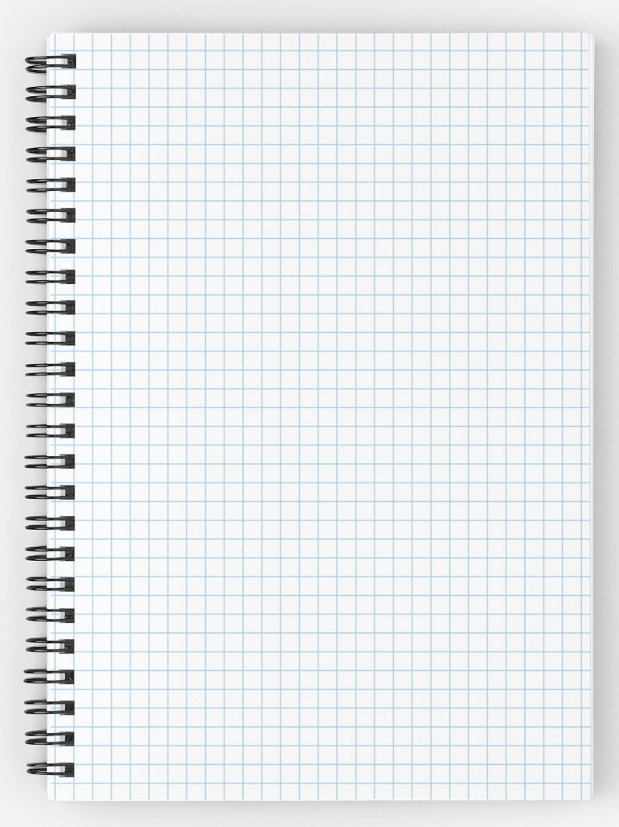
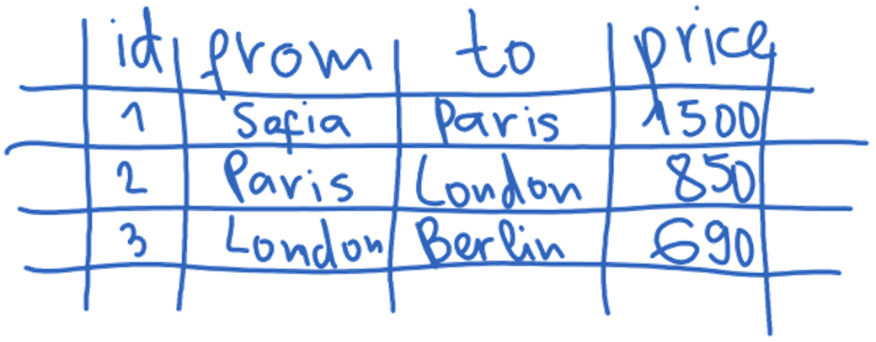

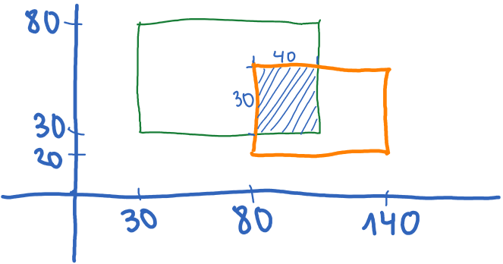
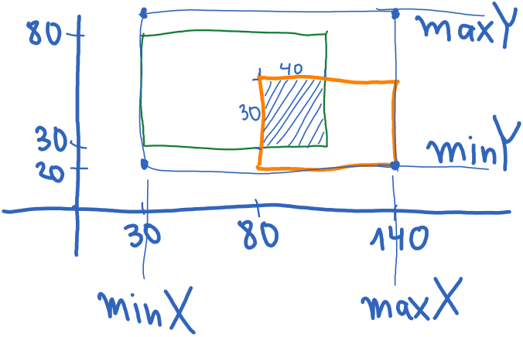
Prefer Squared Paper
Squared paper works best for algorithmic problems
Easy to draw a table
Easy to draw a coordinate system with objects in it
Easy to calculate distances
Easy to sketch a problem and solution ideas
Use pens of different colors
22
Notes:
Prefer squared paper!
It works better for sketching and visualizing your ideas.
Squares helps building drawings, sketches, diagrams, and plans
Squared paper works best for algorithmic problems.
Squared paper allows to draw tables easily.
In many programming problems you need tables.
In this example you have a pricing table consisting of 4 columns ("id", "from", "to" and "price") and 3 rows, which contains prices between pairs of cities.
It is easy to draw a coordinate system with objects in it.
In many programming problems you need a coordinate system.
In graphical user interface (GUI) apps you may need a coordinate system to sketch the user interface.
In this example we have a drawing of two rectangles on the coordinate system and their intersection.
On a sheet of squared paper it is easy to calculate distances.
In many cases distances between objects on the squared paper are visually obvious.
The most important use of squared paper is to easily sketch a problem and solution ideas.
The important point is that you want to be quick in sketching and testing ideas.
You have limited time for the exam, and you must use it wisely.
In this example we have sketched an idea how to find the left, right, top and bottom sides of the objects in the coordinate system.
If you have pens of different colors, take them for the exam.
Some ideas can be illustrated better with different colors.
I personally use only one color, because it takes time to change pens, but it's personal. Some colleagues quickly create excellent drawings using several colors.

Slide 23
Managing Your Time
At the exam you have limited time!
Start with the problem, which will take you the least time
Then, again the problem, which will take you the least time
When you achieve a result of 80/100 or 90/100
Think carefully for the edge cases → try to handle them
After you spend 10-15 minutes on the last few tests, stop!
Don't spend hours for the last 10% of the tests!
Achieving a score of 80-90% of 3 problems is better than 100% of just 1 problem
Notes:
Exam time management is crucial to the success and achievements of the exam.
Remember that at the exam you have limited time!
Start with the problem, which will take you the least time.
This is usually the easiest problem, but it depends on your experience and previous exam preparation.
If you want to achieve the highest possible exam result, you should solve the least time-consuming problem first.
Then, proceed with the problem, which will take you the least time, again.
If you have one problem solved, start solving the least time-consuming problem as a natural next step.
If you take a problem, which is too difficult or time-consuming, you may spend all your time on it and fail the exam.
When we solve problems, it is usual to write almost correct solution, that works the most input cases, but not for all.
At this moment you start debugging and bug fixing in order to improve your solution.
Looking for bugs, debugging and bug fixing can be an almost endless process.
It is quite important to know when to stop!
Otherwise you risk to spend all your exam time on debugging the first problem, instead of solving the other problems.
My tip is when you achieve a result 80 out of 100 or higher for certain problem, to do the following:
Think carefully for the edge cases and try to handle them.
Usually your program will fail for some edge case.
For example, if you have an array of numbers as input, try an empty array or an array of just one element.
Check the ranges of the input data in the problem description (if available) and try testing your code with input, which is close to the limits.
Important: after you spend 10 to 15 minutes on testing and debugging the edge cases or trying to find why your solution is not entirely correct, stop!
Just stop losing your time. Spend your time on the next exam problems instead on a small portion of the current problem.
Don't spend hours to pass the last 10% of the tests!
This is a very common mistake. Don't do it!
Achieving a score of 80% to 90% of 3 problems is much better than 100% of just 1 problem.
I have seen many times at the exams at SoftUni how students spend all their time trying to achieve 100% of the first problem and after 3 or 4 hours they say "I didn't have time for all the problems. The exam was very difficult." or "I had a bad luck: I spent most of my time to find a stupid bug, which I finally fixed, but I didn't have time for the other problems."
Don't do this! After you solve problem incompletely, give it some time for the edge cases and troubleshooting, but limit this time to 15 minutes!

Slide 24
Think Up, Invent and Try Ideas
First take an example of the problem
Sketch it on the sheet of paper
Next try to invent some idea that works for your example
Check if your idea will work for other examples
Try to find a case that breaks your idea
Try challenging examples and unusual cases
If you find your idea incorrect, try to fix it
Or just invent a new idea

Slide 25
Invent and Try Ideas – Example
Consider the "cards shuffle" problem
Idea #1: random number of times split the deck into left and right part and swap them
How to represent the cards?
How to choose a random split point?
How to perform the exchange?
Idea #2: swap each card with a random card
How many times to repeat this?
Is this fast enough?

Slide 26
Invent and Try Ideas – Example (2)
Idea #3: swap 2 random cards a random number of times
How to choose two random cards?
How many times to repeat this?
Idea #4: choose a random card and insert it in front of the deck
How to choose random card?
How many times to repeat this?
Idea #5: do you have another idea?

Slide 27
Decompose the Problem
Work decomposition is natural in engineering
It happens every day in the industry
Projects are decomposed into subprojects
Complex problems could be decomposed into several smaller sub-problems
Technique known as "Divide and Conquer"
Small problems could easily be solved
Smaller sub-problems could be further decomposed as well

Slide 28
Divide and Conquer – Example
Let's try idea #1:
Split the deck into left and right part and swap them (many times)
Divide and conquer
Sub-problem #1 (single exchange) – split the deck into two random parts and exchange them
Sub-problem #2 – choosing a random split point
Sub-problem #3 – combining single exchanges
How many times to perform "single exchange"?

Slide 29
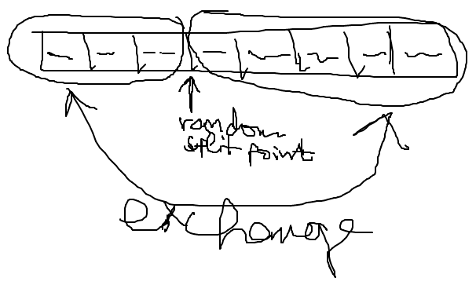
Sub-Problem #1 (Single Exchange)
Split the deck into two parts at random split point
And exchange these 2 parts
We visualize this by paper and pen:

Slide 30
Sub-Problem #1 (Single Exchange)
Choosing a random split point
Need to understand the concept of pseudo-random numbers and how to use it
In Internet lots of examples are available, some of them incorrect
The class Random can do the job

Slide 31
Sub-Problem #1 (Single Exchange)
Combining a sequence of single exchanges to solve the initial problem
How many times to perform single exchanges to reliably randomize the deck?
N times (where N is the number of the cards) seems enough
We have an algorithm:
N times split at random position and exchange the left and right parts of the deck

Slide 32
Check-up Your Ideas
Check-up your ideas with examples
It is better to find a problem before the idea is implemented
When the code is written, changing your ideas radically costs a lot of time and effort
Carefully select examples for check-up
Examples should be simple enough to be checked by hand in a minute
Examples should be complex enough to cover the most general case, not just an isolated case

Slide 33
Check-up Your Ideas – Example
Let's check the idea:
After 3 random splits and swaps we obtain the start position
Seems like a serious problem!

Slide 34
Invent New Idea If Needed
What to do when you find your idea is not working in all cases?
Try to fix your idea
Sometimes a small change could fix the problem
Invent new idea and carefully check it
Iterate
Usually, your first idea is not the best
Invent ideas, check them, try various cases, find problems, fix them, invent better ideas, etc.

Slide 35
Invent New Ideas – Example
Invent a few new ideas:
New idea #1 – multiple times select 2 random cards and exchange them
New idea #2 – multiple times select a random card and exchange it with the first card
New idea #3 – multiple times select a random card and move it to an external list
Let's check the new idea #2
Is it correct?

Slide 36
Check-up the New Idea – Example

Slide 37
Choosing Appropriate Data Structures
Choose appropriate data structures before you start coding
Think how to represent input data
Think how to represent intermediate program states
Think how to represent the requested output
You could find that your idea cannot be implemented efficiently
Or implementation will be very complex or inefficient

Slide 38
Choose Appropriate Data Structures – Example
How to represent a single card?
The best idea is to create a class Card
Face – could be string, int or enumeration
Suit – enumeration
How to represent a deck of cards?
Array – Card[]
Indexed list – List<Card>
HashSet / Dictionary / Queue / Stack – not a fit

Slide 39
Think About the Efficiency
Think about efficiency before writing the first line of code
Estimate the running time (asymptotic complexity)
Check the requirements
Will your algorithm be fast enough to conform with them?
You don't want to implement your algorithm and find that it is slow when testing
You will lose time

Slide 40
Efficiency is not Always Required
Best solution is sometimes just not needed
Read carefully your problem statement
Sometimes ugly solutions could work for your requirements and it will cost you less time
Example: if you need to sort n numbers, any algorithm will work well for n ∈ [0..500]
Implement complex algorithms only when the problem really needs them

Slide 41
Efficiency – Example
How many cards do we have?
In a typical deck we have 52 cards
No matter how fast the algorithm is – it will work fast enough
If we have N cards, we perform N swaps → the expected running time is O(N)
O(N) will work fast for millions of cards
Conclusion:
The efficiency is not an issue in this problem

Slide 42
Five "Easy" Steps to DP
Define subproblems
Guess part of the solution
Relate subproblems and solutions
Recurse and memoization or build DP table
Check subproblems acyclic/topological order
Solve original problem:
A subproblem
Or combination of subproblems

Slide 43
Useful Subproblems for Sequences
Suffixes x[i:]
Prefixes x[:i]
Both approaches usually run in ϴ(x)
Substrings (subsequences) x[i…j]
Usually runs in ϴ(x2)

Slide 44
The "Generic" Shortest Path Algorithm Problems
Complexity might be exponential even for positive edges
Imagine graph with exponential number of edges (paths)
Can end up with complexity of O(2 ^ ^{n/2})
Will not even terminate (endless loop)
If there is a negative weighted cycle reachable from the source
If we are not careful and implement the wrong termination condition

Slide 45
The "Generic" Shortest Path Algorithm
for v in G
d[v] = infinity
prev[v] = null
d[s] = 0
for e in G
relaxation step for E (u, v, w)
// this step is something like compare distances
// if you have better distance write it down etc.
Do the above until you can not relax any edge

Slide 46
Conclusion
Understand the problem
Start from what you know
Build a hypothesis for possible solution
May be incomplete or an approximate such
Test the hypothesis
If it works – implement and test again
If it fails – analyze why did it fail?
If it fails for more than a single point – start again

Slide 47

Summary
Problems P vs NP
Reduction
General Problem-Solving Techniques
Notes:
47

Slide 48
Questions?
Notes:
48

Slide 49














SoftUni Diamond Partners

Slide 50

License
This course (slides, examples, demos, exercises, homework, documents, videos and other assets) is copyrighted content
Unauthorized copy, reproduction or use is illegal
© SoftUni – https://about.softuni.bg/
© Software University – https://softuni.bg
Notes:
50

Slide 51
Trainings @ Software University (SoftUni)
Software University – High-Quality Education, Profession and Job for Software Developers
softuni.bg, about.softuni.bg
Software University Foundation
softuni.foundation
Software University @ Facebook
facebook.com/SoftwareUniversity
Software University Forums
forum.softuni.bg
Notes:
51

